Slide 1
Vendorcom – Future of Merchant Acquiring
11th April 2024

Slide 3
  Today’s Discussion Topics:
1
  Where are merchant payments developing…
2
…how are PSPs evolving…
3
…and how can we work together?

Slide 4
  Today’s Discussion Topics:
1
  Where are merchant payments developing…
2
…how are PSPs evolving…
3
…and how can we work together?

Slide 5
The merchant payment management continuum…
Enterprises are evolving their management and governance of payments – from being focussed on functionality and reach, to owning a P&L and driving growth
  FF
  CC
  GG
Functionality Focused
Cost & Conversion
Growth Generation
KPI / Outcome
Market / payment method launch – customer reach
Auth optimisation
Cost of payment acceptance
GMV / revenue growth
Customer lifetime value
Scope / levers
Engineering/ Config
Limited control over some levers e.g. embedded finance / marketing
Control / strategy across all payment levers
Reporting Function
Finance
Commercial /
Product
Growth

Slide 6
…and the complex set of metrics driving change
As the focus for payments broadens for merchants, so the set of objectives that drive activity become increasingly complex
Build & Run
Optimise
Build customer focused products
Manage the payment business
Manage regulatory obligations
Reach new customers, grow sales & increase revenue
Reduce costs & combat fraud
Product strategy and innovation | Recruit and retain payment teams | Local regulatory obligations |  | Increase conversion of new / existing buyer | Reducing payment processing costs
Product lifecycle management | Strategy / goals / planning support | Tax calculation, collection and reporting |  | Identify optimal payment methods | Reducing losses & fraud
Managing resilience / redundancy | P&L / Performance monitoring & reporting | High risk merchant strategy |  | Retain existing customers and drive frequency | Reducing operational expenses
Supporting partner brands | M&A (purchase & spin-out) | Payment entity / license obligations |  | Cross border payment optimisation
 | Ongoing training/ education | Local/global scheme regulations |  | Embedded Finance / Value Added Services
 |  |  |  | Growth solutions for marketplaces
Understanding customers & market
Partner selection & management
Flow of funds management

Slide 7
Taking an end to end view of the customer
Merchants are also increasingly looking at how payments can improve customer conversion from early in their journeys, even off platform in a effort to create a “buying ready consumer”
Questions merchants ask themselves…
Should I use payment levers to encourage buyers to initiate checkout? (financing/gift cards/logos/loyalty)
Off Platform Marketing / Home Page
Should I require buyers to access checkout via basket?
Product / Item Page
What metrics should I use to measure E2E payment health?
Basket / Cart
What share of checkout drop off relates to third party errors / churn?
Checkout
Post-
Checkout
Should I drive re-purchase / retention post-checkout

Slide 8

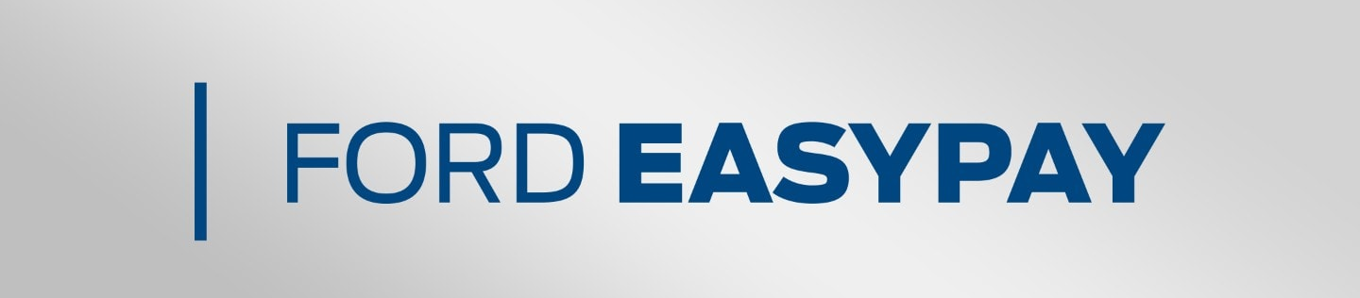
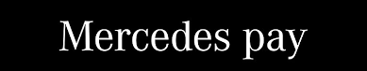
Marketplaces everywhere…
Enterprises are moving to truly "own" the E2E customer journey and are expanding to include relevant adjacent services and products. These experiences are sticky and drive lifetime value
EXAMPLE: Hotels
Ticketing: Art / culture
Eating: Restaurants / gastronomy
Tours/experiences
Shopping
EXAMPLE: Motor
Car purchase financing
Insurance payments
Vehicle servicing, MOTs, tyres and general repairs
Purchase car parts and accessories
In-car service upgrades (e.g. maps, services)
Parking, Petrol, Charging

Slide 9
…and still lots of questions remaining on orchestration
For core functionality enterprises should approach 3rd party orchestration with caution, however it can play a useful role in new/non-core use cases where the incremental costs & risks are more modest
  FF
  CC
  GG
Functionality Focused
Cost & Conversion
Growth Generation
Faster deployment of emerging payment types
Faster deployment in non-core markets
Faster access to new PSPs with specific payment functionality
As a short-term complement to in-house engineering to enable least cost routing, approval optimisation and access to additional payment functionality e.g. tokens/fraud
Ability to “test and learn” with new suppliers on new use cases
Access to additional payment functionality e.g. BaaS
What should it be used for?
Single point of technical & commercial failure with smaller scale suppliers
Reduction in overall service availability esp. for F2F
Mission creep to non-transactional services
Replacing in-house capabilities for core use cases in the medium term
Additional cost for all transactions – even when the value add is focussed in non-core use cases
Reliance on intermediaries in the medium term as their value declines
What needs to be avoided?

Slide 10
So what’s on the mind of large merchants?
In the shorter term there are so many issues which enterprise merchants are looking to understand that there is a distinct case of “paranoid uncertainty”
Operational Efficiency
Payment Types
Innovation
Regulation
Ongoing PCI burden issues
SCA friction and solutions
Transaction/MID localisation and Brexit fall-out
Adoption of network tokens and independent token vaults
Customer payment type steering/incentivisation
Fraud management
Cardholder subscription management services implementation
Use of large data set analytics tools
Use of orchestration (of course!)
Fast checkout options e.g. Bolt, Link, ShopPay
Open Banking and A2A payments
Wero / EPI development and adoption
Apple Pay liability shift and DMA impacts
Apple Pay Later adoption and costs
Localisation of payment types in hard to reach markets e.g. Turkey, Argentina
Internal operation of BNPL services
Cryptocurrency acceptance
Delivering omni-channel customer experiences (NOT payments!)
CBDC (e.g. Digital Euro)
Opportunities to offer a wider range of embedded finance services to buyers and sellers e.g. lending BaaS, travel cards, VCNs
FX and currency localisation
Application of AI to fraud use cases, and automation
Access to better industry data to support use cases (fraud, onboarding etc.)
PSD2 marketplace requirements
PSD3 and PSR requirements on the horizon
Industry access impact from the DMA
US interchange fee settlement and impact on Europe
Evolving US PINless debit and scheme pricing & rules
NON-EXHAUSTIVE!

Slide 11
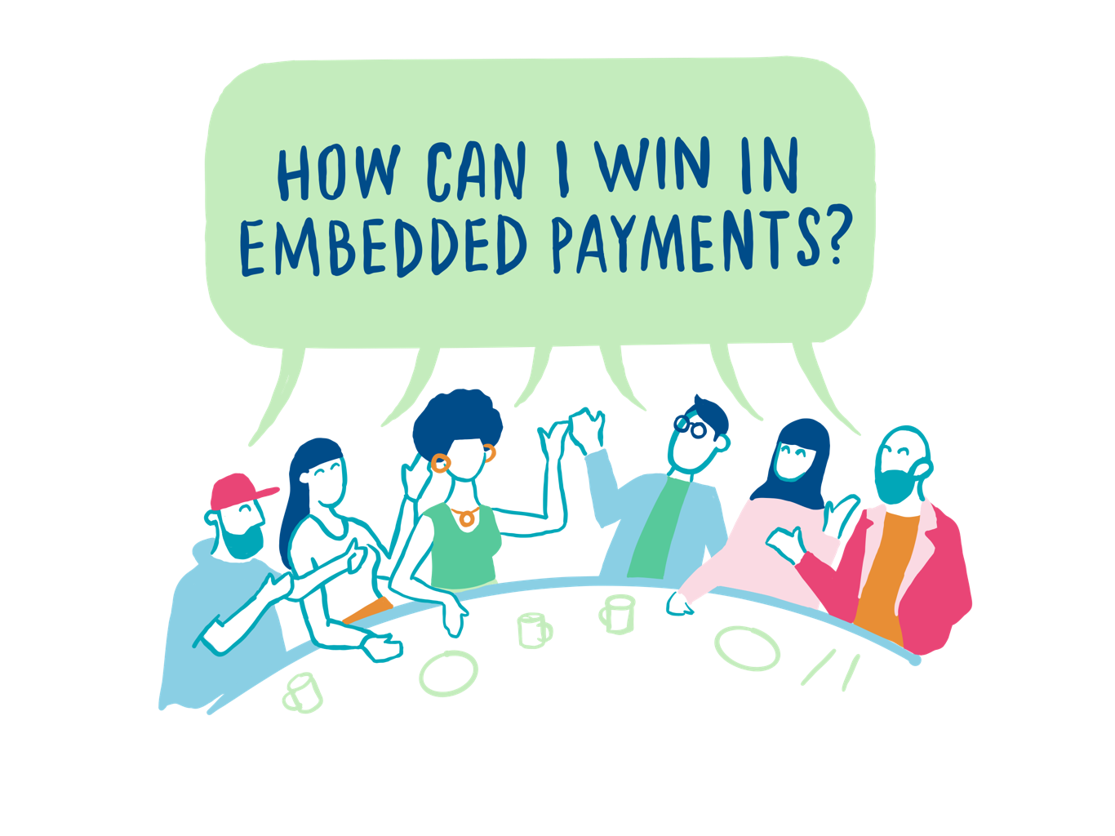




  Do you agree with this view on the evolution of merchant payments?

Slide 12
  Today’s Discussion Topics:
1
  Where are merchant payments developing…
2
…how are PSPs evolving…
3
…and how can we work together?

Slide 13
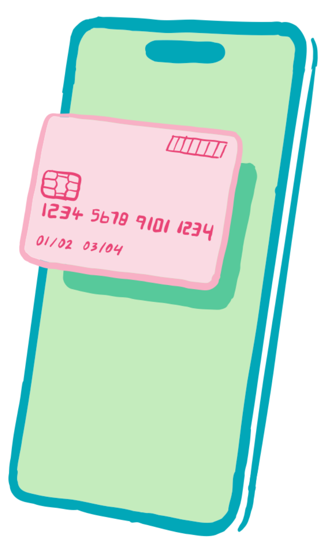
Product innovation is here, but will remain unevenly spread…
For example, basic network token service has been around for some time, and many providers can tick the box, but tech-first acquirers are well advanced in creating a new set of value-added services
Basic token offering…
… and tech-first PSP innovation
Tokenise a scheme card for a specific device or merchant – unique to each scheme
Token management: suspend, resume, cancel a token
PAR enquiry: query a token’s link to the underlying payment account
Single token generating API across all card schemes and payment types within their own gateway
Omnichannel token – track customer activity across ecom, F2F, xPay
A+B testing tools for enterprises to determine whether it is worth implementing network tokens
Smart routing of tokens to optimise approval rates (at BIN levels)
Gateway independent token solutions to allow them to be used across multiple gateways
Transparent fallback to PAN in case tokenised transaction declined
Integrated account updater and wider lifecycle management for issuers who do not support tokenisation
Tokenisation of non-card data e.g. account numbers, personal information etc.

Slide 14
OB & Digital Euro should be seen as opportunities
Despite the uncertainty of A2A payments, acquirers are well places to aggregate push payments into their settlement and reporting capabilities and use their different cost structures to support new use cases
Originally conceived A2A model
“New” A2A
and D€ Model
  Consumer
  Merchant
  Payee
  Consumer
  Merchant
  Payee
  Single transaction, immediate settlement, no visibility of funds flow
  D€ DEAN
  TPP
  Bulk settlement, value add and visibility due to control over the flow of funds
  TPP
  “Acquirer”
  Payee
  “Acquirer”
  Payee
  D€ DEAN
  Funds Flow
  Messaging

Slide 15
Rapid, existential, change in acceptance distribution models…
WHERE IS THE UK EMBEDDED PAYMENTS MARKET TODAY?​
Software platform distribution is set to dominate the future of payment acceptance as ISOs and PacFacs get replaced by SaaS players with sticky business relationships with merchants
  64%
  no commercial relationship
Q: What type of relationship do you have with your primary payment partner?
Source: PSE software providers survey 2023
Key:
Non-commercial relationships
Commercial relationships

Slide 16








…selling more than just a payments acceptance API
In response to the growing scope of enterprise merchant requirements, acquirers are increasingly seeking to tie together a wider set of embedded finance services – this will be the future of acceptance
“TradFi” Label
Proposition/Use Case Support
Example Suppliers
  Money In
  Acquiring
  Accept B2B & B2C payments in-store and online for immediate and invoice payments
  Support for all relevant payment types: cards, BNPL, DDs, FPS, etc.
  Funds Management
  Current Account
  Automated/instant supplier or customer (AR/AP) a/c creation within tool
  Automated recon. of all in/outbound txns
  Unique IBANs for invoice generation
  Lending
  Merchant Cash Advance
  Lending to merchants and consumers
  Faster lending decisioning
  Controlled collection of funds based on share of pay-in
  Money Out
  Remittances
  Enhanced control through purchasing cards
  Expense mgt through employee cards
  Seamless international funds movement

Slide 17
  Where else could PSPs evolve?

Slide 18
  Today’s Discussion Topics:
1
  Where are merchant payments developing…
2
…how are PSPs evolving…
3
…and how can we work together?

Slide 19
How is this all going to work?
  Solve costly pain points for merchants of all sizes, rather than…
  …trying to fit technology solutions into existing use cases
  Jointly iterate MVP products between PSPs and merchants, rather than…
  …relying on other parts of the payments value chain to innovative for you
  Using regulation and risk as opportunity to deliver new services, rather than…
  Using it as an excuse not to innovate
Jointly work together to…

Slide 20
  Time for more questions!

